Slide 1
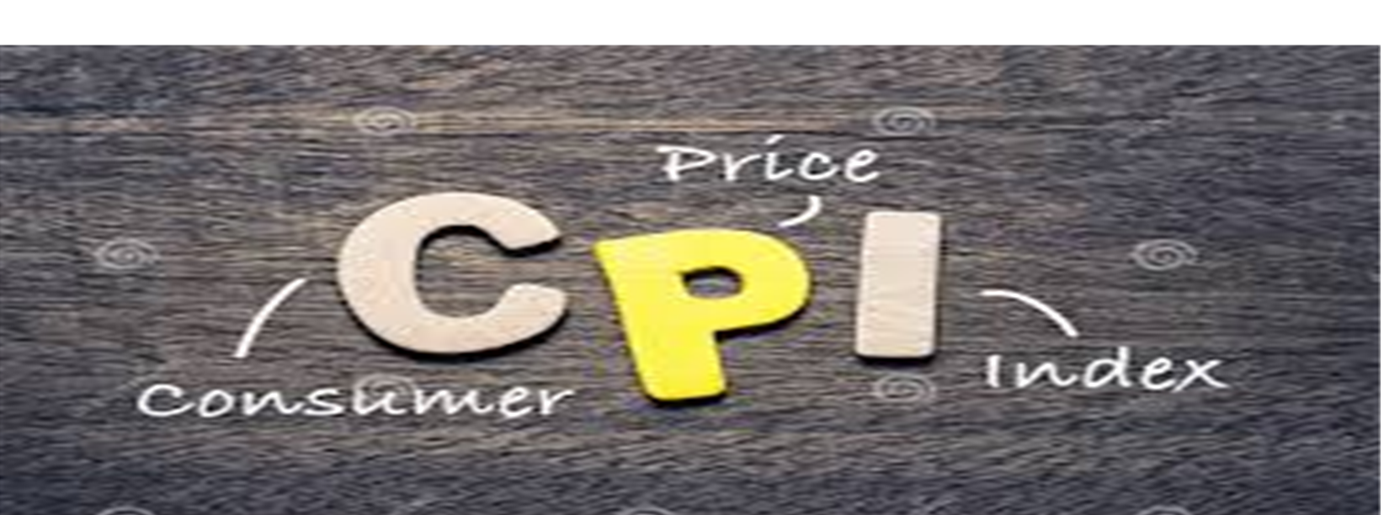
IS THE CPI BEST MEASURE OF INFLATION?

Slide 2
PRESENTRS
Suraj panjwani
Zamanullah
Sakshi Karara
Hira Shaikh
Sadhori Gopchandani

Slide 3
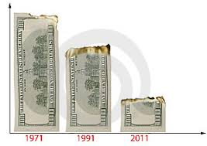
INFLATION
Inflation is the percentage increase in the prices of goods and services in a given time period.
When the prices of an economy rise then overall purchases power of individual got reduced

Slide 4
Positive impacts of inflation
Better savings accounts rates
Cheaper to travel abroad
Offsets negative effects of deflation
Wages will be higher
Get cost of living adjustments

Slide 5
Negative impacts of inflation
Low salary
Low pension
Lower the value of treasury notes
Borrowing money is more expensive
Stuff cost more
Long term savings might erode

Slide 6
Whole Sale Price Index
Definition: It is an indicator that measure the price changes of goods before the retail level. WPI concern with goods that are sold in huge quantity like trade between two businesses.
Example; Trade between Nikee and Gucci.

Slide 7

Course Instructor:
Dr.Asim Ali Samejo

Slide 8

Mr.Tanveer Ahmed
Student of Electrical Engineering at Sukkur IBA University
Semester 4th
Cms Id:033-20-0030
Email:tanveerahmed.beef20@iba-suk.edu.pk

Slide 9

Mr. Habibullah
Student of Electrical Engineering at Sukkur IBA University
Semester 4th
Cms Id:033-20-0026
E-mail:habibullah.beef20@iba-suk.edu.pk

Slide 10
Maximum Power Point Controller(MPPT)
NO Yes
No Yes No Yes
Measure
V(k).I(Ik)
Calculate P(K)
P(k)>p(k-1)
V(k)>V(k-1)
V(k)>V(k-1)
Vref=Vref+c
Vref=Vref+c
Vref=Vref-c
Vref=Vref+c
P(k-1)=p(k)

Slide 12
Consumer price index
CPI is used to measure inflation.
CPI measure the cost of fixed set(basket) consumer goods and services related to cost of same quantity, same goods and services in a base period
It is the average commodity consumed by a class of people so that they can maintained the same standard of living in the current year to the base year.

Slide 13
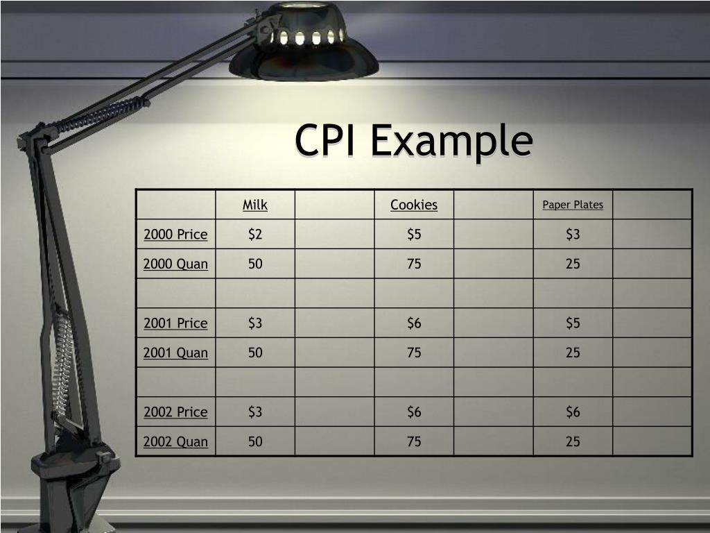
Formula of CPI
CPI _{current year} = cost of market basket in current period/ cost of market basket in base period

